Slide 1

#BeyondPossible
Capstone Project
PROJECT - 3
ETL Pipeline for Healthcare Data

Slide 2

THE PROBLEM
A healthcare provider needs to manage and analyze patient data effectively to enhance their diagnostic and treatment capabilities
The diabetes dataset contains critical information such as glucose levels, BMI, age, and more, which can be used to monitor patient health
This project aims to build an ETL (Extract, Transform, Load) pipeline using Azure Databricks to streamline the data processing workflow and derive actionable insights from the diabetes dataset

Slide 3
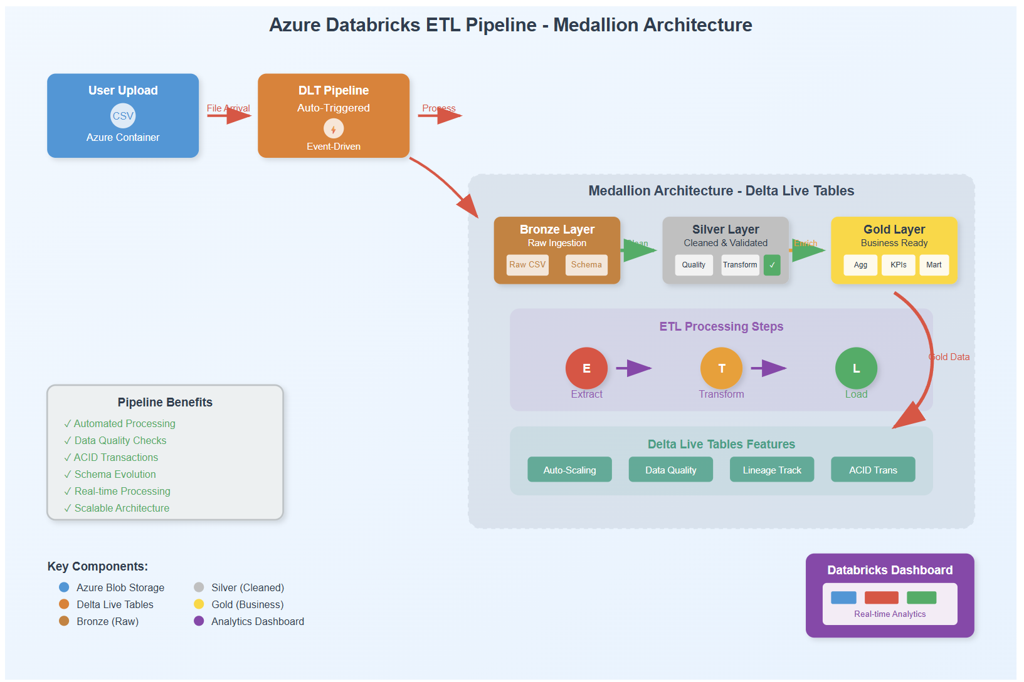
Workflow Diagram

Slide 4
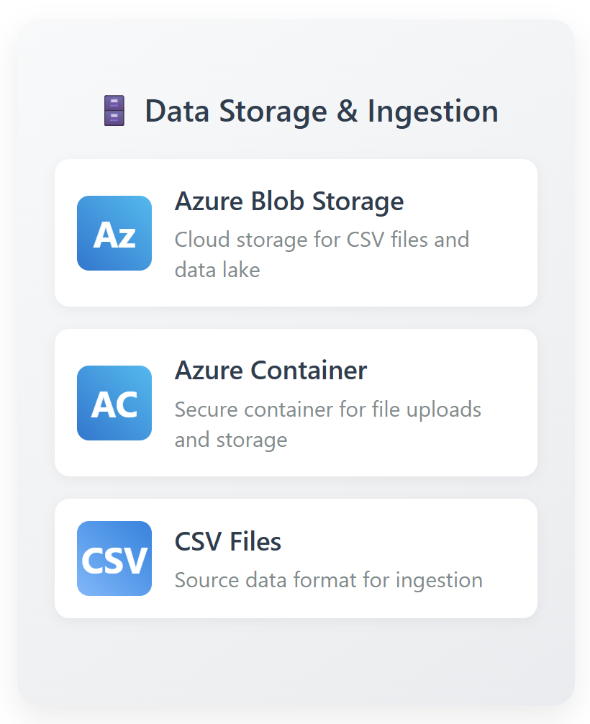
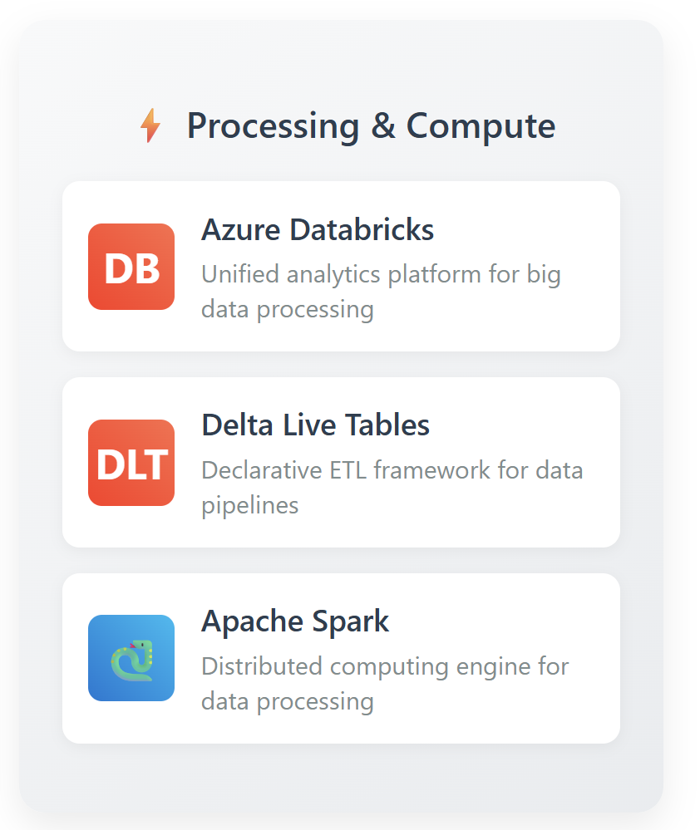
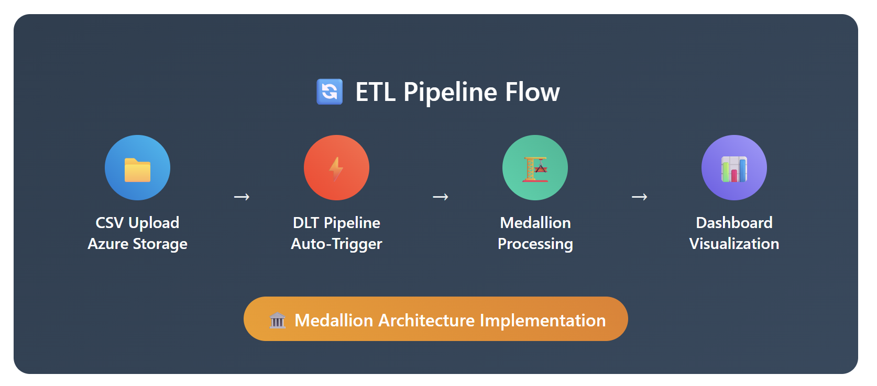
Tech Stack

Slide 5
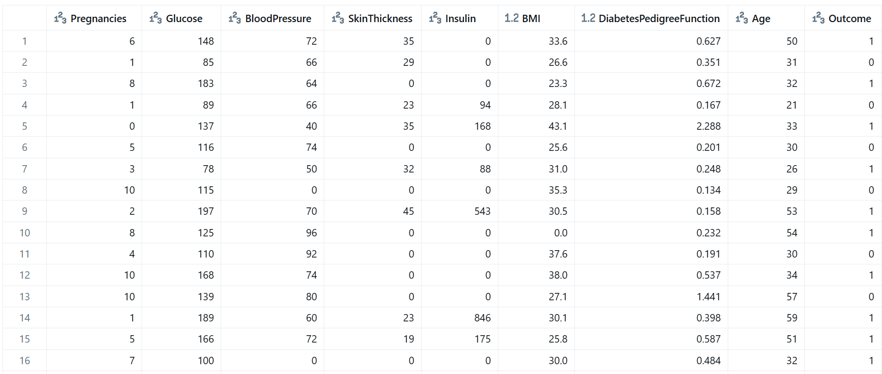
DIABETES DATA

Slide 6
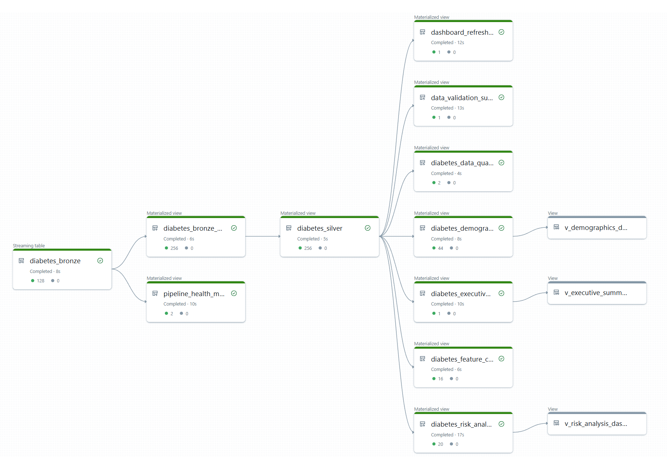
DLT PIPELINE

Slide 7

EXTRACT

Slide 8
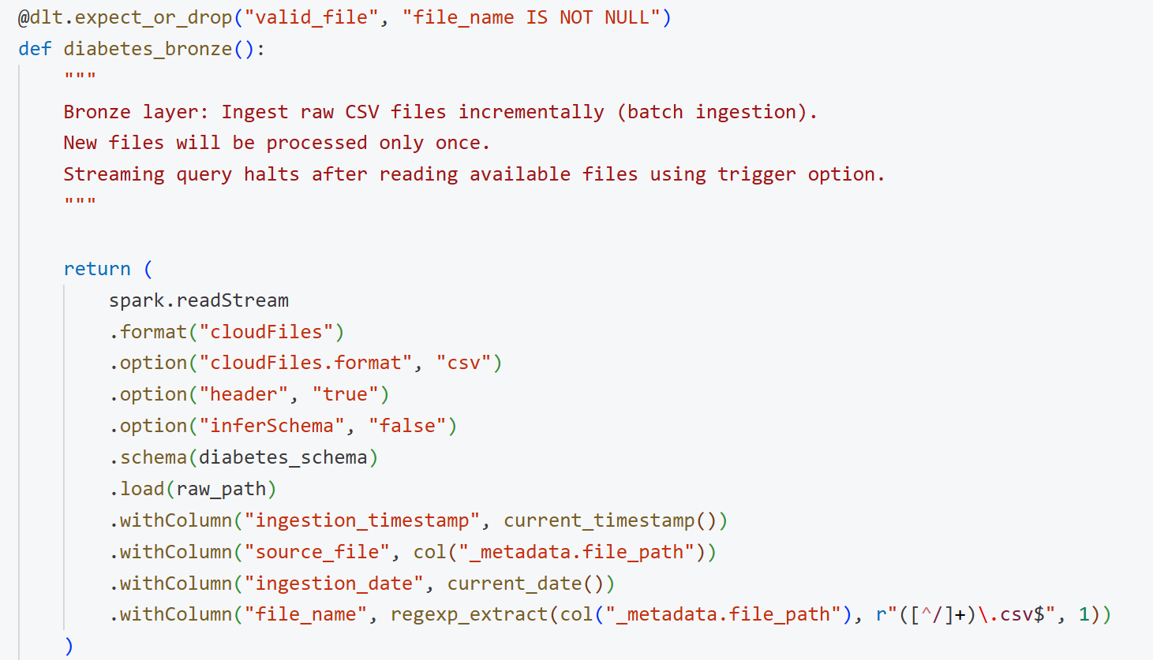
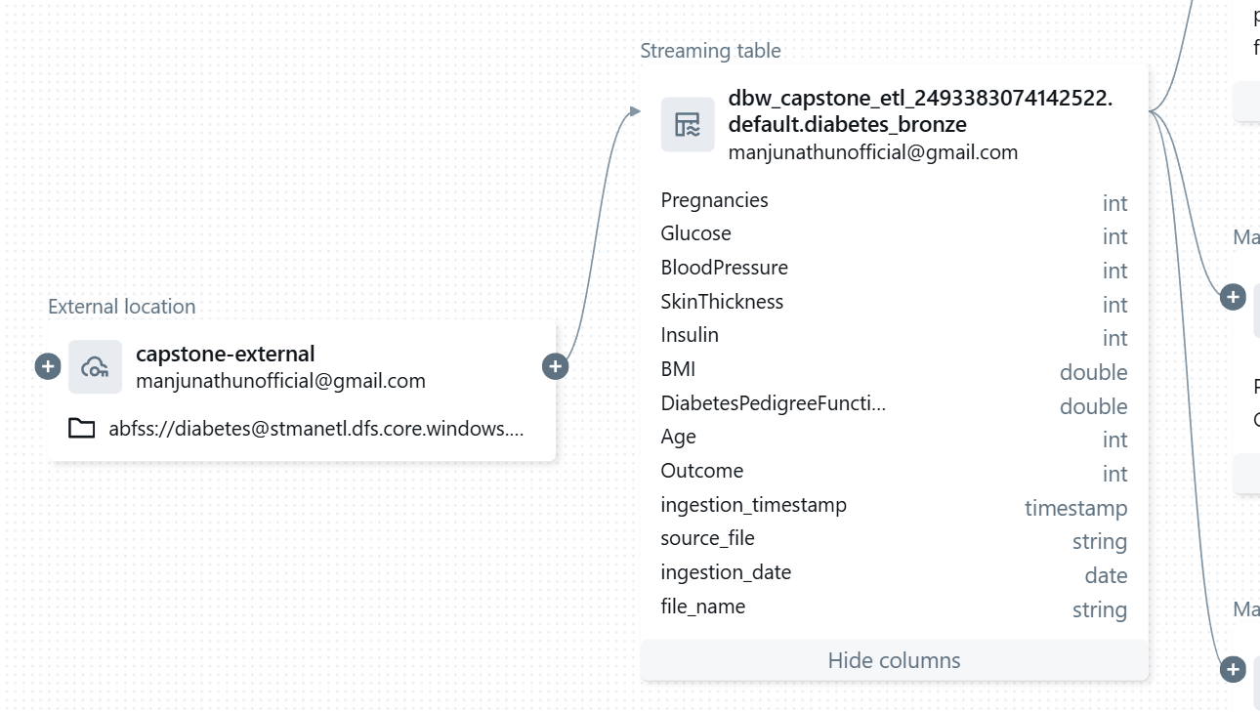
EXTRACT

Slide 9

TRANSFORM

Slide 10
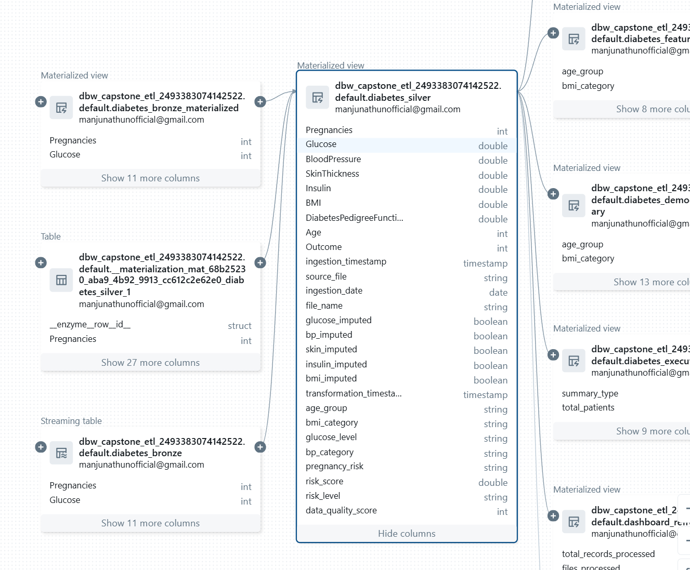
TRANSFORM
Null checks
Zero values handling
Median imputation
Validation (like 0<Age<120)
Feature Engineering:
age_group: Age categorization
bmi_category: BMI classification
glucose_level: Glucose level categories
bp_category: Blood pressure categories
pregnancy_risk: Pregnancy-based risk
risk_score: Comprehensive diabetes risk score
risk_level: Risk level categorization
data_quality_score: Data completeness score

Slide 11

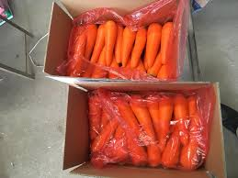
LOAD

Slide 12
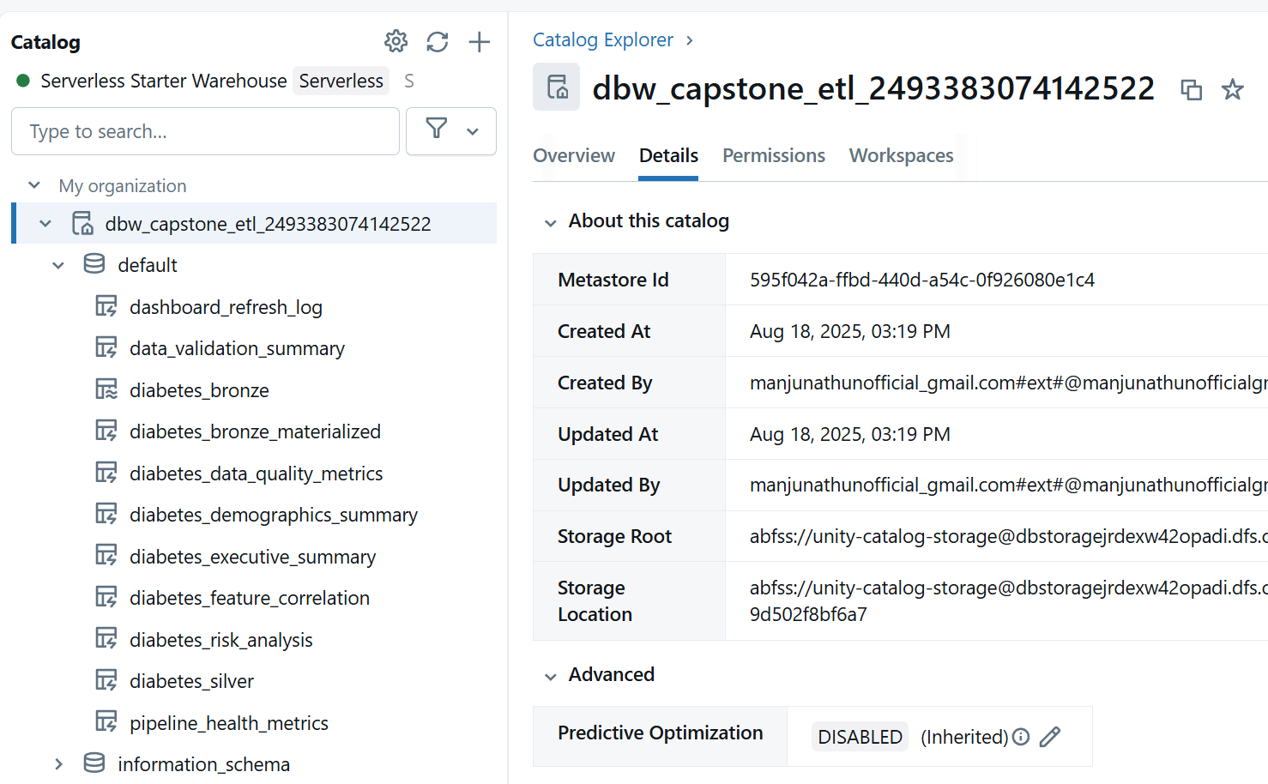
LOAD
Gold layer aggregates are materialized as Delta Live Tables

Slide 13
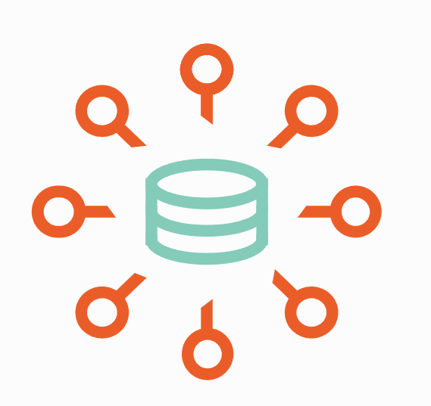
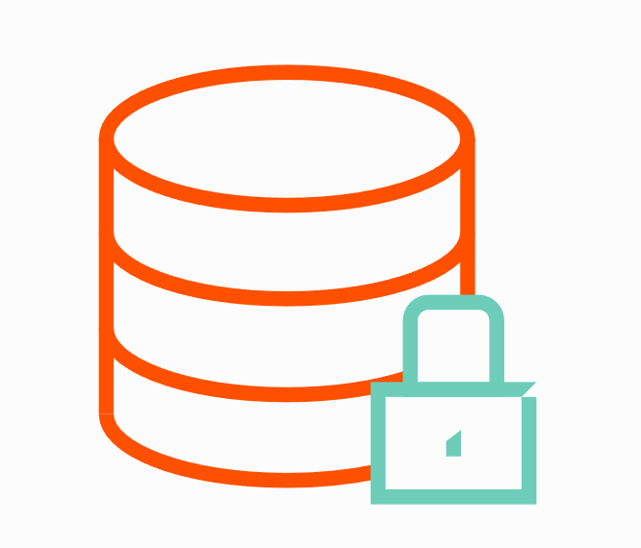
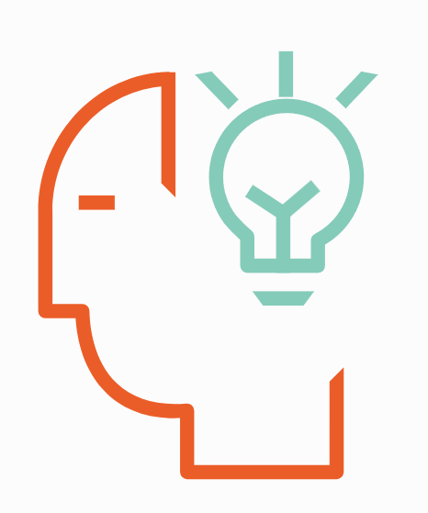
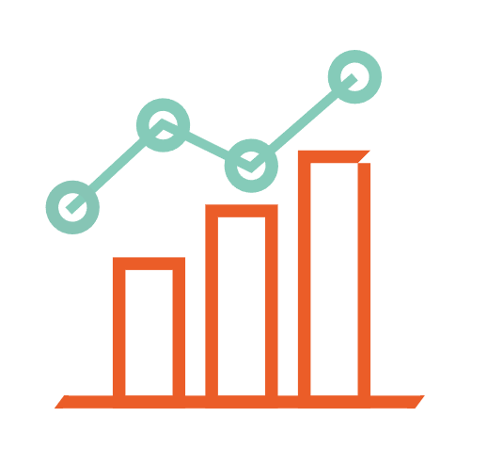
Salient Features
Near Real-time Analysis
Monitoring and Validation
Secure access
File arrival based trigger
E2E TAT of less than 5 mins
Dashboard refresh frequency of 1 min
Cost optimized and efficient
Usage of Delta Live Tables

Slide 14
Challenges and workarounds
Couldn’t get global aggregation of median for imputation on streaming table
Use window or a materialized table for aggregation
The workspace in vendor account gets cleared often
Need to have conventions and ready to deploy project

Slide 15

Future Scope
Assure Container??
Blab storage??

Slide 16
Future Scope
Abstraction Layer
Provide simpler upload option to the user (Google Drive)
Better risk prediction
Usage of AI/ML models on the dataset for better predictions
Real time streaming
Extend Autoloader with streaming to handle IOT/medical devices

Slide 17
